Slide 1

CSE- 458
VLSI Design Lab

Slide 2
Hardware Description Language
A hardware description language (HDL) is a specialized computer language used to describe the structure and behavior of electronic circuits, and most commonly, digital logic circuits.
The structure, operation and design of the circuits are programmable using HDL.
HDL includes a textual description consisting of operators, expressions, statements, inputs and outputs.
Instead of generating a computer executable file, the HDL compilers provide a gate map.

Slide 3
Hardware Description Language
The gate map obtained is then downloaded to the programming device to check the operations of the desired circuit.
The language helps to describe any digital circuit in the form of structural, behavioral and gate level.
The three common HDLs are
Verilog
VHDL
SystemC
SystemC is the newest. The HDLs will allow fast design and better verification. In most of the industries, Verilog and VHDL are common.

Slide 4
Hardware Description Language
Verilog HDL
Verilog was introduced in 1985 by Gateway Design System Corporation, now a part of Cadence Design Systems, Inc.'s Systems Division.
Verilog was made an IEEE Standard in 1995
Syntax based on C programming language.
VHDL (“V” short for VHSIC)
[Very High Speed Integrated Circuits]
Designed for and sponsored by US Department of Defense.
Designed by committee (1981- 1985).
Its roots draw from the Ada programming language.
Syntax based on Ada or Pascal programming language.
VHDL was made an IEEE Standard in 1987

Slide 5
Hardware Description Language
VHDL | Verilog
Government Developed | Commercially Developed
Ada based | C based
Strongly Type Cast | Mildly Type Cast
Case-insensitive | Case-sensitive
Difficult to learn | Easier to Learn

Slide 6
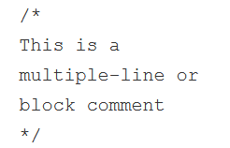
Verilog syntax
Number Format
We are most familiar with numbers being represented as decimals. However, numbers can also be represented in binary, octal and hexadecimal. By default, Verilog simulators treat numbers as decimals.
Comments
There are two ways to write comments in Verilog.
A single line comment starts with // and tells Verilog compiler to treat everything after this point to the end of the line as a comment.
A multiple-line comment starts with /* and ends with */ and cannot be nested.

Slide 7
Verilog syntax
Operators
There are three types of operators: unary, binary, and ternary or conditional.
Unary operators shall appear to the left of their operand
Binary operators shall appear between their operands
Conditional operators have two separate operators that separate three operands
x = ~y; // ~ is a unary operator, and y is the operand
x = y | z; // | is a binary operator, where y and z are its operands
x = (y > 5) ? w : z; // ?: is a ternary operator, and the expression (y>5), w and z are its operands

Slide 8
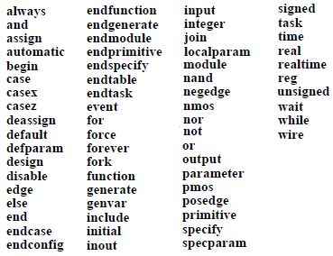
Verilog syntax
Keywords
Keywords are special identifiers reserved to define the language constructs and are in lower case. A list of important keywords is given below.

Slide 9
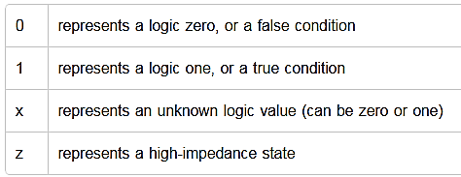
Verilog syntax
What values do variables hold ?

Slide 10
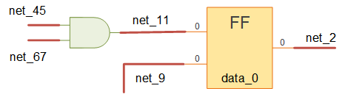
Verilog syntax
Nets and Variables
Nets and variables are the two main groups of data types which represent different hardware structures and differ in the way they are assigned and retain values.
Nets
Nets are used to connect between hardware entities like logic gates and hence do not store any value on its own.

Slide 11
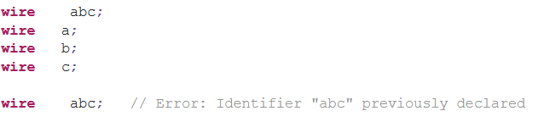
Verilog syntax
Nets and Variables
There are different types of nets each with different characteristics, but the most popular and widely used net in digital designs is of type wire. A wire is a Verilog data-type used to connect elements and to connect nets that are driven by a single gate or continuous assignment.

Slide 12
Verilog syntax
Nets and Variables
integer
An integer is a general purpose variable of 32-bits wide that can be used for other purposes while modeling hardware and stores integer values.
integer count;
time
A time variable is unsigned, 64-bits wide and can be used to store simulation time quantities for debugging purposes. A realtime variable simply stores time as a floating point quantity.
time end_time; // end_time can be stored a time value like 50ns
real
A real variable can store floating point values and can be assigned the same way as integer and reg.
real float; // float = 12.344 - can store floating numbers

Slide 13
Verilog syntax
Nets and Variables
Verilog Strings
Strings are stored in reg, and the width of the reg variable has to be large enough to hold the string.
Each character in a string represents an ASCII value and requires 1 byte.
If the size of the variable is smaller than the string, then Verilog truncates the leftmost bits of the string.
If the size of the variable is larger than the string, then Verilog adds zeros to the left of the string.
Vector Data
reg [7:0] eightbitbus; // 8-bit reg vector with MSB=7 LSB=0 The reg [7:0] means you start with 0 at the rightmost bit to begin the vector, then move to the left.

Slide 14
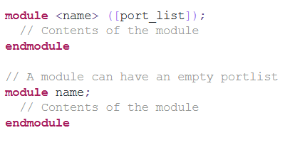
Verilog syntax
Verilog module
A module is a block of Verilog code that implements a certain functionality. Modules can be embedded within other modules and a higher level module can communicate with its lower level modules using their input and output ports.
A module should be enclosed within module and endmodule keywords. Name of the module should be given right after the module keyword and an optional list of ports may be declared as well. Note that ports declared in the list of port declarations cannot be redeclared within the body of the module.

Slide 15
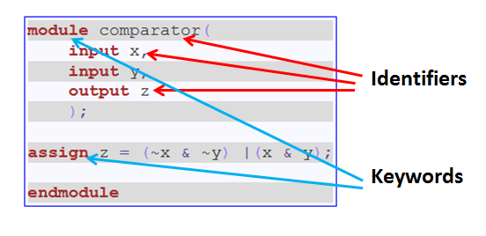
Verilog syntax
Verilog module

Slide 16
Verilog Program
Write a simple program in Verilog program
and run it.

Slide 17
Verilog Program
Now create a new file called hello.v in the directory C:/iverilog/bin and edit it with notepad or any other text editor(notepad++). Enter the following lines of code in hello.v
module main;
initial
begin
$display("Learning Verilog");
$finish ;
end
endmodule
Ref: http://www.referencedesigner.com/tutorials/verilog/verilog_02.php

Slide 18
Verilog Program
Go to your DOS prompt
( Start - > cmd ) and navigate to the directory C:/iverilog/bin
Run iverilog using the command
C:\>iverilog\bin > iverilog main.v
If you have done everything right, it should generate a file called a.out which you can run using command
C:\>iverilog\bin > vvp a.out
Alternately, create a new executable file
C:\>iverilog\bin > iverilog -o main main.v
C:\>iverilog\bin > vvp main
module main;
initial
begin
$display("Learning Verilog ");
$finish ;
end
endmodule

Slide 19
Verilog Program
Write a Verilog program for basic logic gate.

Slide 20
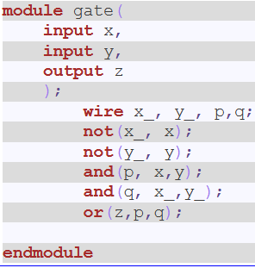
Verilog: Basic Gate

Slide 21
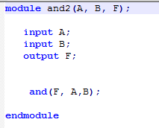
Verilog: AND Gate

Slide 22
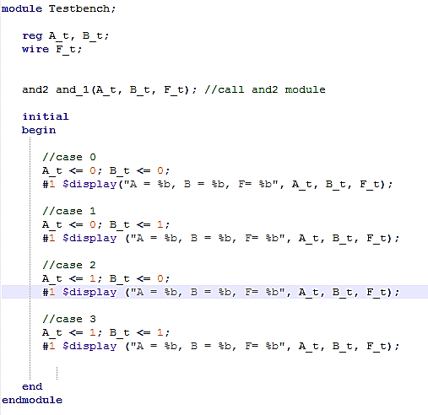
Verilog: AND Gate

Slide 23
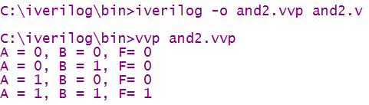
Verilog: AND Gate
Now go to the directory C:\> cd iverilog\bin Compile the program using C:\iverilog\bin>iverilog -o andgate and2.v If everything goes right, it will not produce any output. To see the output of the stimulus, you may like to give the following command C:\iverilog\bin>vvp andgate
Output:

Slide 24
Comparator
A digital comparator is a hardware electronic device that takes two numbers as input in binary form and determines whether one number is greater than, less than or equal to the other number.
There are two main types of Digital Comparator available and these are.
Identity Comparator – an Identity Comparator is a digital comparator with only one output terminal for when A = B, either A = B = 1 (HIGH) or A = B = 0 (LOW)
2. Magnitude Comparator – a Magnitude Comparator is a digital comparator which has three output terminals, one each for equality, A = B greater than, A > B and less than A < B

Slide 25
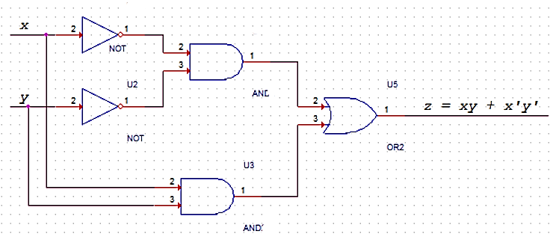
One bit comparator (Identity Comparator)
Basically when both the inputs x and y are same, the output z is 1. When the inputs are unequal, the output is 0.

Slide 26
One bit comparator (Identity Comparator)
z = (~x & ~y)|(x & y);
Input x | Input y | Output z
0 | 0 | 1
0 | 1 | 0
1 | 0 | 0
1 | 1 | 1

Slide 27
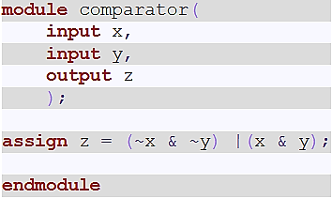
One bit comparator (Identity Comparator)
code:

Slide 28
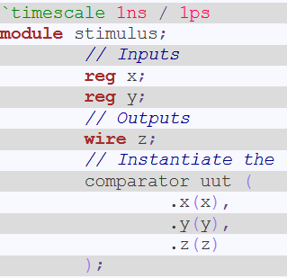
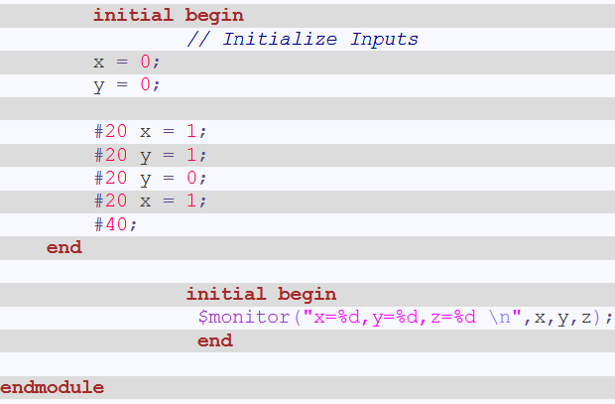
One bit comparator (Identity Comparator)

Slide 29
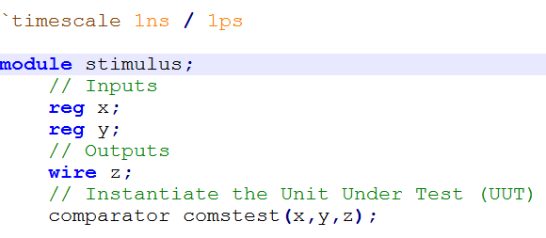
One bit comparator (Identity Comparator)

Slide 30
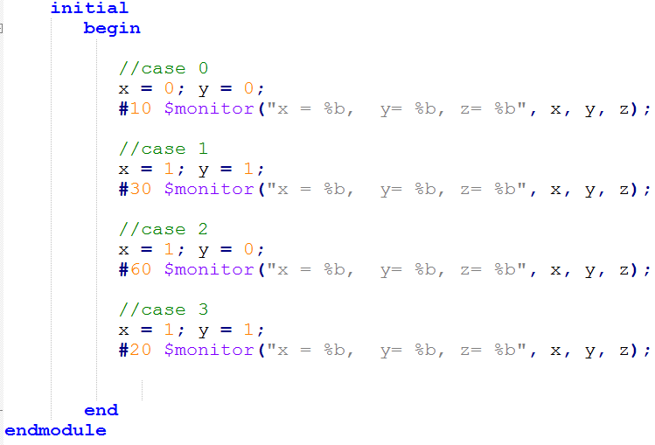
One bit comparator (Identity Comparator)

Slide 31
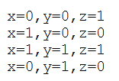
One bit comparator (Identity Comparator)
Output:

Slide 32
One bit comparator (Identity Comparator)
Now go to the directory C:\> cd iverilog\bin Compile the program using C:\iverilog\bin>iverilog -o comparator.vvp comparator.v stimulus.v If everything goes right, it will not produce any output. To see the output of the stimulus, you may like to give the following command C:\iverilog\bin>vvp comparator.vvp
Output:

Slide 33
Comparator
In the single bit comparator, we had only two sets of 1 bit input.
What if we need to design a comparator that has two sets of 2 bit input
?

Slide 34
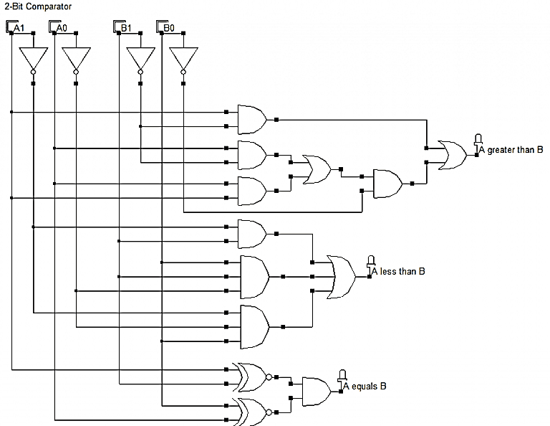
Comparator

Slide 35
Comparator
A1 | A0 | B1 | B0 | A>B | A<B | A=B
0 | 0 | 0 | 0 | 0 | 0 | 1
0 | 0 | 0 | 1 | 0 | 1 | 0
0 | 0 | 1 | 0 | 0 | 1 | 0
0 | 0 | 1 | 1 | 0 | 1 | 0
0 | 1 | 0 | 0 | 1 | 0 | 0
0 | 1 | 0 | 1 | 0 | 0 | 1
0 | 1 | 1 | 0 | 0 | 1 | 0
0 | 1 | 1 | 1 | 0 | 1 | 0
1 | 0 | 0 | 0 | 1 | 0 | 0
1 | 0 | 0 | 1 | 1 | 0 | 0
1 | 0 | 1 | 0 | 0 | 0 | 1
1 | 0 | 1 | 1 | 0 | 1 | 0
1 | 1 | 0 | 0 | 1 | 0 | 0
1 | 1 | 0 | 1 | 1 | 0 | 0
1 | 1 | 1 | 0 | 1 | 0 | 0
1 | 1 | 1 | 1 | 0 | 0 | 1

Slide 36
Comparator

Slide 37
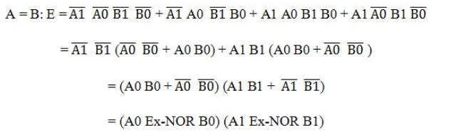
Comparator

Slide 38
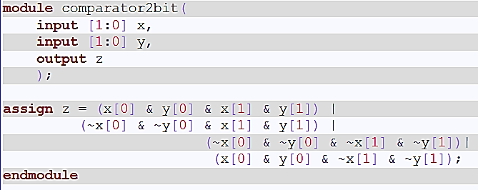
Comparator

Slide 39
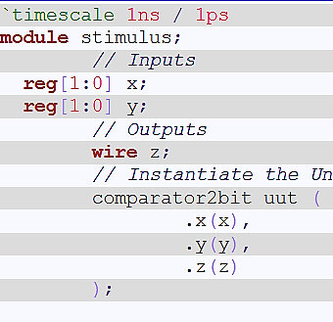
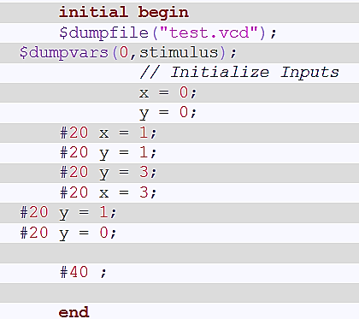
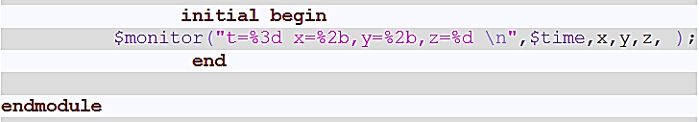
Comparator

Slide 40
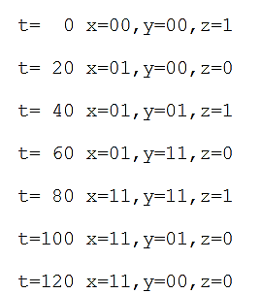
gtkwave test.vcd &
Comparator

Slide 41

Viewing Waveform using GTKWave
now extend our comparator example to see how we can use the gtkwave to view waveform. You need to add the following two lines of code in the stimulus file.
Run the gtkwave with following commands
gtkwave test.vcd &

Slide 42
Viewing Waveform using GTKWave

Slide 43
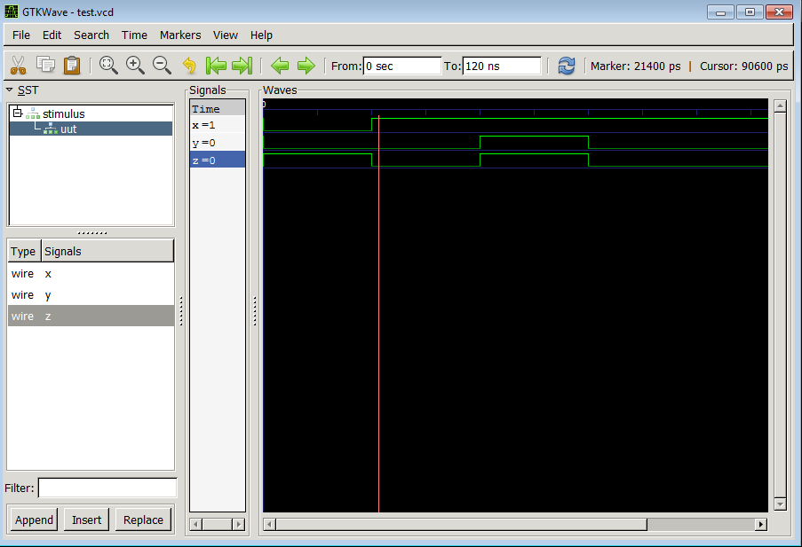
Viewing Waveform using GTKWave

Slide 44

Thanks to All

